Slide 1

MYSQL Functions

Slide 2
MySQL Functions
Functions are simply pieces of code that perform some operations and then return a result.
Some functions accept parameters while other functions do not accept parameters.
Types of functions
Built-in functions
MySQL comes bundled with a number of built in functions. These functions allow us to perform different types of manipulations on the data. The built in functions can be basically categorized into the following most used categories.
Strings functions – operate on string data types
Numeric functions – operate on numeric data types
Date functions – operate on date data types
Aggregate function – operate on all of the above data types and produce summarized result sets.

Slide 3

String Functions
String Functions
String functions are used to manipulate
Text data in MySQL. CONCAT,SUBSTR,UPPER,LOWER,
RIGHT,LEFT,REPLACE,REVERSE,RPAD,LPAD,LENGTH,
TRIM are some of the most commonly used functions.
These functions can help you to format and clean
up your data to ensure consistency and accuracy

Slide 4
String Functions
Name | Description | Example
CONCAT | Concatenate two or more strings into a single string | select concat(city_id,'-',city_name) from city;
INSTR | Return the position of the first occurrence of a substring in a string | select instr(city_name,'o') from city; Select INSTR(‘sutudent1@ibridge360.com','@')—return 10
LENGTH | Get the length of a string in bytes and in characters | select length(city_name) from city;
LEFT | Get a specified number of leftmost characters from a string | select LEFT(city_name,3) from city;--Return 3 character
RIGHT | Get a specified number of rightmost characters from a string | select RIGHT(city_name,3) from city;--Return 3 character from right side
MID | This function in MySQL is used to extract a substring from a given input string | Syntax:MID(text, start position,no_of_characters) select mid(city_name,1,4) from city;
LOWER | Convert a string to lowercase | Select LOWER(city_name) from city;
UPPER | Convert a string to uppercase | Select UPPER(city_name) from city;
LTRIM | Remove all leading spaces from a string | select ltrim(" mysql") from dual;
RTRIM | Remove all trailing spaces from a string | select rtrim("mysql ") from dual;
INSERT | The INSERT() function inserts a string within a string at the specified position and for a certain number of characters. | SELECT INSERT("sql.com", 1, 3, "mysql");---mysql.com

Slide 5
String Functions
Name | Description | Example
REPLACE | Search and replace a substring in a string | REPLACE(str, find_string, replace_with) select replace('malayalam','a','z') from dual; select replace(customer_name,customer_name,customer_address) from customer;
SUBSTRING | Extract a substring starting from a position with a specific length. | SELECT SUBSTR("MySQL Tutorial", 7,8) AS ExtractString from dual;
SUBSTRING_INDEX | Return a substring from a string before a specified number of occurrences of a delimiter | SELECT SUBSTRING_INDEX("www.mysql.com", ".", 2);---Return ‘www.mysql’
TRIM | Remove unwanted characters from a string. | SELECT TRIM(' My SQLTutorial ') AS TrimmedString; select trim(leading 'z' from 'zzmysql') as db_name from dual; --leading specific character is removed select trim(trailing 'z' from 'mysqlzzz') as db_name from dual;
REVERSE() | Reverses a string and returns the result. | Select reverse('MySQL') as reverse_string
LOCATE() | LOCATE function is used to find the position of a substring within a string | LOCATE(substring, string, start) select locate(‘o’,‘helloworld’)—5 Select locate(‘o’,’helloworld’,6) -- 7

Slide 6

Number Functions
Numeric Functions
MySQL numeric functions are used primarily
for numeric manipulation and/or mathematical
Calculations. POWER,ABS,ISNUMERIC,SIGN
TRUNCATE ,POWER,SQRT,CEIL,FLOOR,ROUND are
some of the most commonly used functions

Slide 7
Number Functions
Name | Description | Example
ABS | Returns the absolute value of numeric expression | select abs(-15) –return 15
POWER | Returns the value of one expression raised to the power of another expression | select power(2,3) –8
SQRT | Returns the non-negative square root of numeric expression. | select sqrt(25)
ROUND | Returns numeric expression rounded to an integer. Can be used to round an expression to a number of decimal points | SELECT ROUND(545895.6877562);--545895 SELECT ROUND(545895.6877562, 3);--545895.688
CEIL | it accepts an integer value as a parameter and returns the smallest integer not less than the given value. | SELECT CEIL(2254.554); --2255 SELECT CEIL(-2254.554); 2254
FLOOR() | Returns the largest integer value that is not greater than passed numeric expression. | SELECT floor(2254.554); --2254 SELECT CEIL(-2254.554); 2255

Slide 8
Number Functions
Name | Description | Example
TRUNCATE() | The TRUNCATE() function of MySQL is used to limit the given number to the desired number of decimal digits | SELECT TRUNCATE(6546841.489484, 0); --6546841 SELECT TRUNCATE(6546841.489484, 3);--6546841.489 SELECT TRUNCATE(-6546841.489484, 3); -6546841.489 SELECT TRUNCATE(-6546841.489484, 0); --6546841
PI | The PI() function returns the value of PI. | SELECT PI();
RAND([N]) | Returns a random floating-point value v in the range 0 <= v < 1.0 | select city_id,rand() from city

Slide 9

Date and Time Functions
Date and Time Functions
MySQL date/time functions are used to manipulate temporal values.Sysdate,year,month,day,time,date(),adddate() some of the most commonly used Date functions.These functions can help you to filter and sort the data based on specific date and time ranges

Slide 10
Date and Time Functions
Name | Description | Example
SYSDATE(),current_timestamp(),now | MySQL SYSDATE() returns the current date and time in YYYY-MM-DD HH:MM:SS | Select sysdate() select current_timestamp() select now()
ADDDATE() or date_add Date_sub | The ADDDATE() function can be used to perform arithmetic operations on dates, such as adding or subtracting days, weeks, months, or years ADDDATE(date, INTERVAL expr unit) Date – Date Interval – Keyword Expr - A date or datetime expression or a number. Unit - An unit | -- what is the date after 7 days SELECT ADDDATE(sysdate(), INTERVAL 7 DAY);-- what is the date of 3 months back SELECT ADDDATE(sysdate(), INTERVAL -3 MONTH); -- Add 2 years current yearSELECT ADDDATE(sysdate(), INTERVAL 2 YEAR);
ADDTIME() | adds expr2 to expr1 and returns the result | SELECT ADDTIME(sysdate(),'1:00:00') –add 1 hr for now

Slide 11
Date and Time Functions
Name | Description | Example
Curdate()/current_date() | Returns today’s date | select curdate(); Select current_date;
Curtime()/current_time() | Returns current time | select curtime()select current_time()
Date() | Extracts the date part of the date or datetime expression expr. Returns NULL if expr is NULL. | SELECT DATE(sysdate()); ---2023-07-17
DATEDIFF(expr1,expr2) | returns expr1 − expr2 expressed as a value in days from one date to the other | SELECT DATEDIFF(sysdate(),'2023-09-17');
DATE_FORMAT(date,format) MONTH | Formats the date value according to the format string. If either argument is NULL, the function returns NULL. | select date_format(sysdate(),'%m'); ---- month numeric select date_format(sysdate(),'%M'); ----- complete month description select date_format(sysdate(),'%b'); -- 3 leters in month
STR_TO_DATE(str,format) | Which converts string to date format | SELECT STR_TO_DATE('01,5,2013','%d,%m,%Y'); SELECT STR_TO_DATE('May 1, 2013','%M %d,%Y');

Slide 12
Date and Time Functions
Name | Description | Example
DATE_FORMAT(date,format) DAY | Formats the date value according to the format string. If either argument is NULL, the function returns NULL. | select date_format(sysdate(),'%d'); ---- day in numbers select date_format(sysdate(),'%W'); ----- complete day descriptionselect date_format(sysdate(),'%a'); -- 3 leters in day
DATE_FORMAT(date,format) YEAR | Formats the date value according to the format string. If either argument is NULL, the function returns NULL. | select date_format(sysdate(),'%Y'); -- year in 4 digitsselect date_format(sysdate(),'%y'); -- year in 2digits
LAST_DAY(date) | akes a date or datetime value and returns the corresponding value for the last day of the month | select last_day(sysdate()) –31
DAYOFWEEK | Returns the weekday index for date (1 = Sunday, 2 = Monday, …, 7 = Saturday). These index values correspond to the ODBC standard. Returns NULL if date is NULL. | SELECT DAYOFWEEK(sysdate()); Sunday = 0
QUARTER(date) | Returns the quarter of the year for date, in the range 1 to 4, or NULL if date is NULL. | SELECT quarter(sysdate())

Slide 13

Aggregate function
Aggregate Function Descriptions
This section describes aggregate functions that operate on sets of values. They are often used with a GROUP BY clause to group values into subsets.

Slide 14
Aggregate function
Name | Description | Example
avg | Return the average value of the argument | select avg(cost) from product
sum | Return the average value of the argument | select sum(cost) from product
max | Return the maximum value | Select max(cost) from product
min | Return the minimum value | Select min(cost) from product
COUNT() | Return a count of the number of rows returned | select count(pc_id) from product ---8 records
COUNT(DISTINCT) | Return the count of a number of different values | select count(distinct pc_id) from product –3 records

Slide 15

ISNULL and IFNULL Functions
ISNULL
The MySQL ISNULL() function is used to check for any NULL values in the expression passed to it as a parameter. If the expression has/results to NULL, it displays 1. If the expression does not have or result in NULL, the function returns 0.
IFNULL
The MySQL IFNULL() function is used to return a specified value if the expression is NULL. If the expression is not NULL, IFNULL() returns the expression.

Slide 16
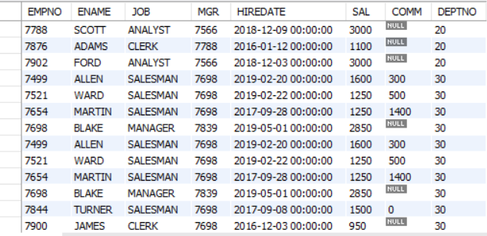
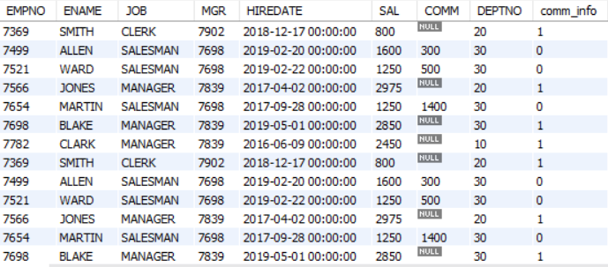

ISNULL
EMP TABLE –INPUT TABLE
select *,isnull(comm) as comm_info from EMP
Null Value returns 1 and not null value returns as 0
select deptno,sum(isnull(comm)) as nocomm
from EMPS
group by deptno ---Returns department wise count of employee are not getting commission
Working with isnull
select isnull(123) ---0
select isnull(1/0) ---1
select isnull("Jessa") ---0

Slide 17
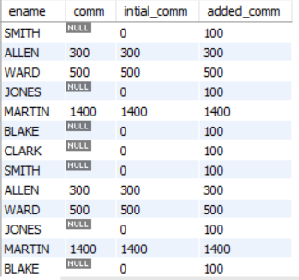
IFNULL
EMP TABLE –INPUT TABLE
select ename,comm,ifnull(comm,0) as intial_comm,
ifnull(comm,100) as added_comm
from EMPS ---If commission is null intial_comm shows 0
if you want to replace 0 with other amount pass second
argument how much commission you have to add

Slide 18
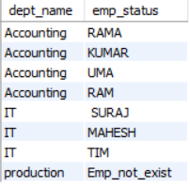
IFNULL
select dept_name,ifnull(emp_name,'Emp_not_exist') as emp_statusfrom department d left join emp e
on d.dept_id = e.dept_id
Shows department wise employee name if employee not exist instead of showing null its shows as emp_not_exist

Slide 19
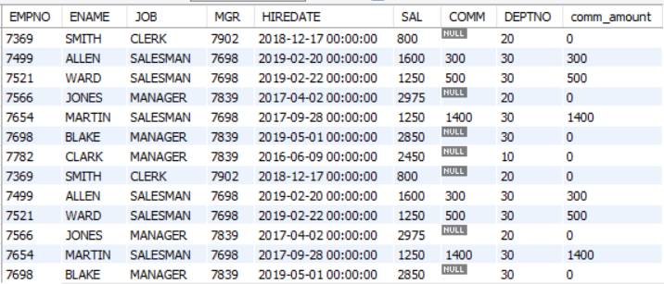
COALESCE
COALESCE--Helps us to return the first non-null values in the arguments.
SELECT *,COALESCE(COMM,0) as comm_amount
from EMPS ---Coalesce function returns not null values
second argument null values replaced with 0
EMP TABLE –INPUT TABLE

